Slide 1
SOMERSET PURPOSE
Somerset Academy, Inc. promotes a transformational culture that maximizes student achievement and the development of accountable, global learners in a safe and enriching environment that fosters high-quality education.
S - Set high expectations
O - Objective
M - Meaningful curriculum
E - Effective
R - Resourceful and responsible life long learners
S - Scholars who achieve proficiency and beyond
E - Evaluate continuously and use data to drive curriculum
T - Teachers who are highly qualified

Slide 2
LINCOLN MEMORIAL UNIVERSITY
http://www.lmunet.edu/
Application Fee waived for SCPA students
In state tuition offered
Harrogate, TN
Bachelor of Science
Athletic Training
Veterinary Health Science
Criminology and Criminal Justice
Social Work
Environmental Science
Bachelor of Arts
Art
Media Communications
Business
Political Science
Associates of Science in Nursing
Bachelor of Science in Nursing
Bachelor of Business Administration
Accounting
Marketing

Slide 3
DO NOT. . .
“Hang out” in the stairwells or on the second floor during lunch.
Chew gum. DO NOT BRING GUM!
Go on the basketball court with a skateboard!
Use the elevator without approval from the office.
Leave campus if you are a Middle Schooler, Freshman or Sophomore (Except for DE students)
Allow an underclassmen in your vehicle without prior permission, or you will lose all privileges for the remainder of the school year.
Throw anything off the balcony.
Throw anything from the ground level to the 2nd floor.
Eat or carry food over the basketball court or turf field
Litter or leave garbage around at lunch
Hang out by the wavy wall side or behind the basketball court bleachers
Hang on or grab the basketball nets/rims
Playing “keep away” = a detention
Sweat pants/yoga pants/ leggings/ are not allowed. Not even during dress down days. Dress code violations earn detentions
You are not to go to the Deans’ office during class to argue a detention. You will be turned away.

Slide 4
NO FOOD ON THE COURT

Slide 5
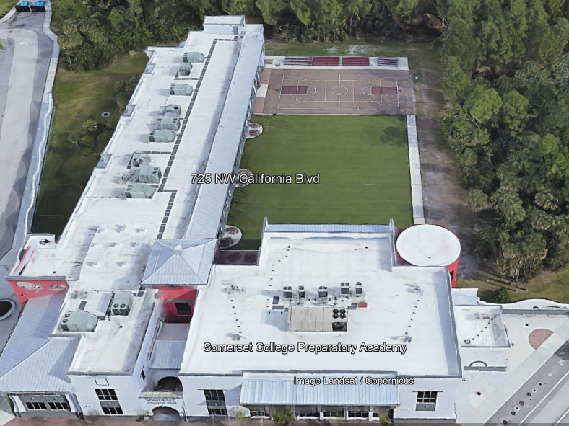
There is NO open food or liquid on the turf!!!
If you are caught, you will be having a meeting with the deans
TURF!

Slide 6
Tutoring Schedule
Mondays – ENGLISH (please see the schedule for which teach is staying for tutoring. The schedule is posted in all English teacher Classrooms)
Tuesdays – Math (ALL Math teachers)
Wednesdays – Social Studies
Thursdays – Science
Fridays – NONE
Need tutoring for electives? See your teacher to schedule.

Slide 7
September 26th -30th

Slide 9
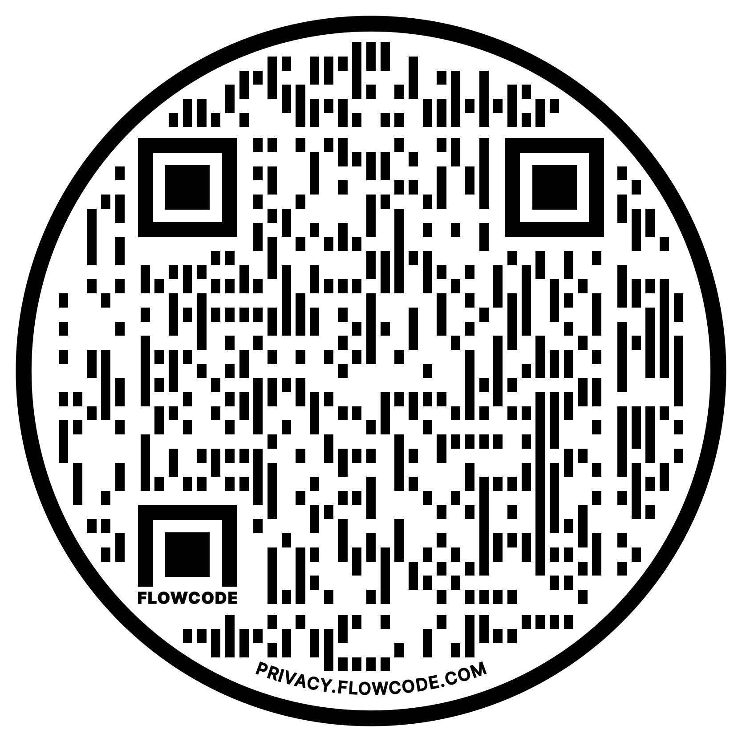
BREAST CANCER WALK
Robin’s Spartans
In support of Breast Cancer awareness month and to honor Ms. Robin who is a 2+ year survivor, SGA will be attending the “Making Strides” walk at Tradition Square.
The walk will take place on Saturday, October 22 from 8:00 a.m. to 11:00 a.m. However, participants must be there by 7 a.m.
Volunteer hours will be awarded to those who attend and donate to the cause $10 = 1 hour
Panera Bread will provide free breakfast to registered survivors and thrivers (not to those who just joined the walk).
All supporters will have their name on a ribbon that is hung on the cafeteria windows.
To join the team or make any donations, Scan the qr code above.

Slide 11
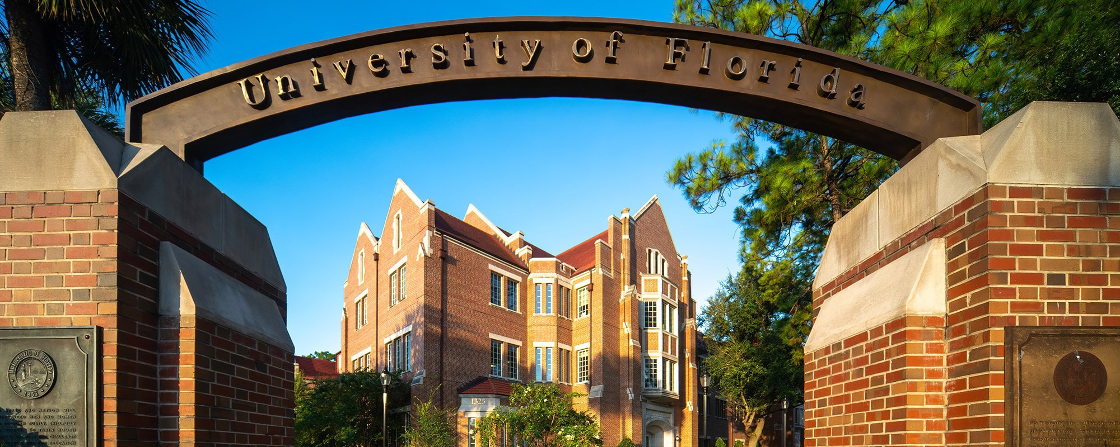
The University of Florida will be here today @ 10:00 AM in the cafeteria, providing an information session.
We will announce when seniors and juniors can come to the cafeteria to attend the info session this morning.

Slide 12
SCPA takes PSL
Meetings can go until 10:00 pm, so students are not required to stay the whole time. SGA members will be leaving at 8:30pm; therefore the cap per meeting is TWO volunteer hours.
An opportunity to sit in on an official City Council meeting!
Join SGA at City Hall, every 2nd and 4th Monday of the month
Address: 121 SW Port St Lucie Blvd, Port St. Lucie, FL 34984 – Building A
Meetings are at 6:30 pm, beginning on September 26th
Topics are published ten days prior to each meeting on the calendar linked below so you can attend the meetings that interest you:
https://www.cityofpsl.com/government/calendar
Open to all interested high schoolers, and volunteer hours will be awarded to students who sign in with an SGA member (members
will be present and in school uniform)
Uniform is not required but attire should be appropriate
(Transportation is not provided)

Slide 13
Save the Date!
Attention all high schoolers!
SGA will be hosting an "Out of this World" Homecoming Dance here at SCPA on November 11th from
6pm – 10pm.
More details regarding price, permission forms, and running for homecoming court to come!!
This event is only for CURRENT 9-12 grade students.
Students on Academic or Behavior Probation will NOT be allowed to attend.
NO middle schoolers are allowed.

Slide 14
Create a Greeting Card Scholarship
Scholarship is open to all high school, college, and university students. The only eligibility criteria is that students must be at least 14 years or older at the time of entry (so some middle school students may even be able to apply). Home-schooled students are also welcome apply.
There is no required “theme,” but check out the Gallery website so that your card creation falls under one of the card lines featured.
The Gallery website states that while Christmas cards are their biggest sellers, birthday and anniversary cards are also popular. Have a penchant for sympathy or “get well” messages? Those themes are also welcome. Be sure to browse the Gallery website for ideas, but also remember that their cards are targeted to a corporate clientele.
The main criteria looked at:
Overall aesthetic appeal
Quality of execution
Creativity and Originality
Successful incorporation of design elements
Appropriateness for use as a greeting card

Slide 15
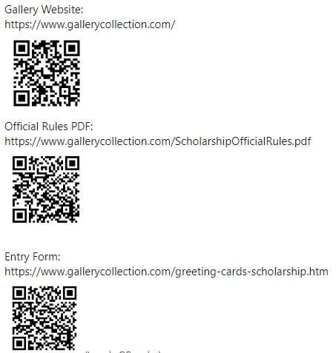
Create a Greeting Card Scholarship
The applicant with the winning entry will receive a cash scholarship of $10,000 plus a $1,000 prize for their school!
The winner’s award is paid directly to the school they will/are attending.
The Contest ends at 11:59:59 p.m. ET, March 02, 2022.

Slide 16
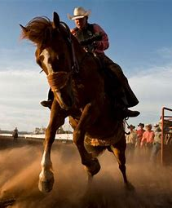
Cowboys And Cowgirls Theme Nights
Dress up for a rodeo and come support SCPA vs. TCH in their girls' volleyball game on September 27, 2022.
School Appropriate Clothing is still Required! No Spurs!
Attire only permitted for games, not for the school day!
Admission Prices
$2 with student ID
$3 children
$5 adult

Slide 17
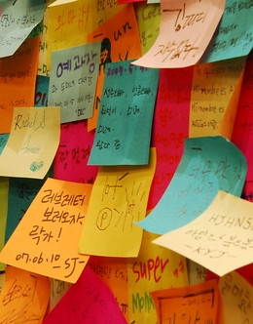
Post-it Positivity
Join SGA during the Post-it positivity event!
Write positive messages on sticky notes to your favorite teachers and leave them on the Science wing wall and Building C’s court room wall!
Sep 19th through October 7th for all students
Disclaimer: Detentions will be issued if you use profanity, inappropriate imagery, or remove sticky notes.

Slide 18
Come Support the following students that donated their pottery to the 30th Annual Soup Bowl fundraising event on Thursday, November 3rd, 2022
ALL Pottery Bowls will be available for view/purchase on Thursday, November 3, 2022, from 9:00 am- 7:00 pm only at the Heritage Center, in downtown Vero Beach. The donation requested for each bowl is $15.
The minimum donation continues to be $5 for a bowl of soup and $15 for a quart container of ‘soup-to-go’; however, the idea is to donate what you would have spent on that meal had you gone out to eat instead.’
Addyson Langen Alex Jaffe Amare Payne Ariana Albuquerque Atticus Agnew Ayden Salinas Ayden WIlson Brianna Armas Brianna Xavier | Brooke Peters Brooke Slater Christine Ortiz Christopher Nichols Corby Henderson David Horne David Onuoha Dlorah Lopez | Jahsai Arnoux Jaimoni Parker Jordan Folk Lexi Pyle Torres Leyla Abrahams Mackenzie Roberts Madison Gordan Marissa Indrigo | Marlee Apple Martha Jones Natalie De Souza Olivia Rios Tori Huckstep Victoria Purificato Vivianna Colon

Slide 19
Calling all artists!
FAU’s Harbor Branch is accepting Ocean Science Art from September 5th, 2022 to March 17th 2023, but they haven’t gotten a chance to update their website yet!
Please come see Mrs. Perez in 235 or email her at perez.lindsey@somersetcollegeprep.org
🏆K- 8th Grade Winner: “Harnessing the Power of Marine Sponges” by Trisha G., 7th grade
🏆High School Winner: “Coral” by Alex T., 12th grade
🏆 Adult Winner: “In Awe” by Linda S.
🏆People’s Choice Award Winner: “Tubed System” by Pjark S., 11th grade
More updates to come!!!

Slide 20
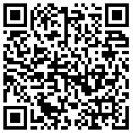
Calling all 6th to 8th Grade Artists!
The Florida Department of Health Radon Program is sponsoring the 2023 Florida Radon Poster Contest They select the Florida winners and celebrate their success. Students then move up to the National Contest for even more fame and glory!
What’s so important about radon, you ask? Radon is the leading cause of lung cancer among non-smokers in the U.S. and 1 in 5 homes in Florida have elevated radon levels.
Poster prizes: 1st place –$1,000 2nd place –$300 3rd place – $200
Deadline: November 1, 2022.
Please Contact Mrs. Perez in 235 or at perez.lindsey@somersetcollegeprep.org

Slide 22
TURF DURING LUNCH
Volleyball
Monday-Friday: NO SPIKING!!!
Basketball
Monday/Wednesday: Middle school only
Tuesday/Thursday: Highschool only
Rotate Fridays

Slide 23
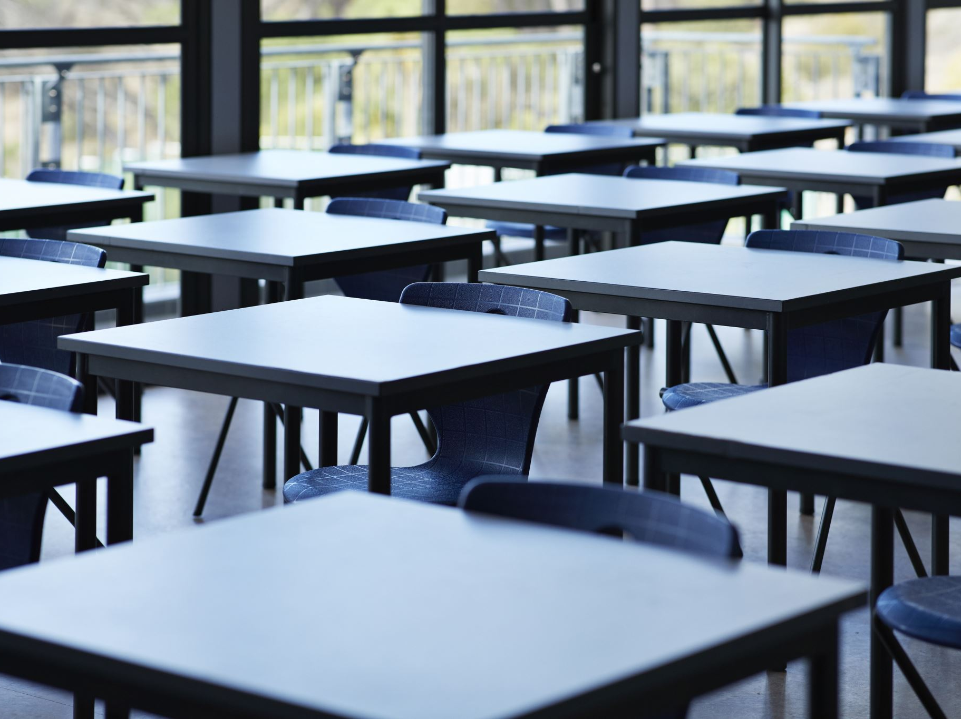
Clubs
Chorus Club for high school on Mondays, after school, in 268
Salsa Dancing in 136, on Tuesdays and Thursdays at lunch.
SGA, every other Wednesday, after school, from 3:45-5 in room 222
Girls and Boys Soccer Club, Tuesdays and Thursdays, after school, from 4-5:30 on the turf.
GSA on Wednesdays in 169 at lunch 11:55am-12:30pm
ASL on Wednesdays in the theater room, at 12pm on lunch.
Chorus Club for middle school on Thursdays, after school, in 268
Senior Committee Meeting, after school, in 136
Chess Club on Thursdays, during lunch, in 132

Slide 24
House Reminds
For anyone who needs the house remind this year ☺ This is important for communication with your house head.
Ares-@houseare
Athena-@scpaathena
Hestia- @househes
Poseidon- @psdnscpa
Zeus-@housezeus

Slide 25
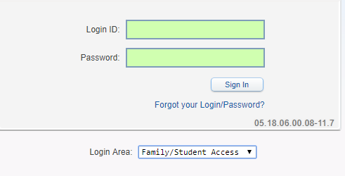
Student Skyward Access
Login ID: (Student 562#)
Password: (8 Digit Birthdate - MMDDYYYY)
Example: 08032005
**You May access Skyward through the school’s website.

